Slide 1
Module 4
Lecture 4:
Bayesian Networks
Markov Models

Slide 2

Bayesian Belief Network in artificial intelligence:
Bayesian Network can be used for building models from data and experts opinions, and it consists of two parts:
Directed Acyclic Graph.
Table of conditional probabilities.

Slide 3
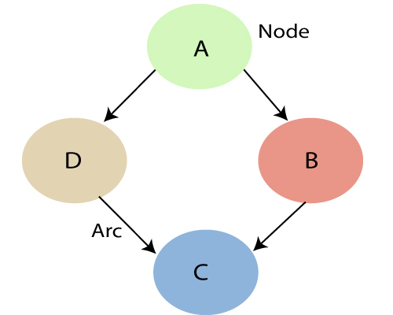

Slide 4
Each node in the Bayesian network has condition probability distribution P(X_{i} |Parent(X_{i}) ), which determines the effect of the parent on that node. Bayesian network is based on Joint probability distribution and conditional probability. So let's first understand the joint probability distribution:

Slide 5
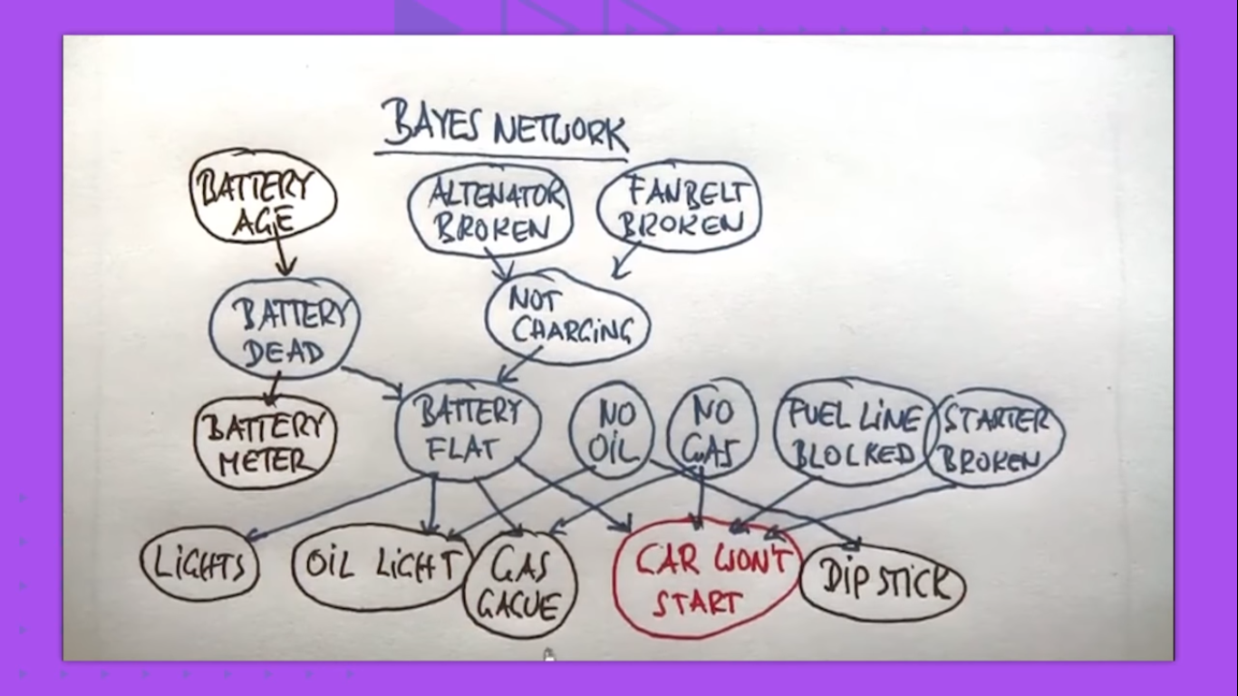

Slide 6
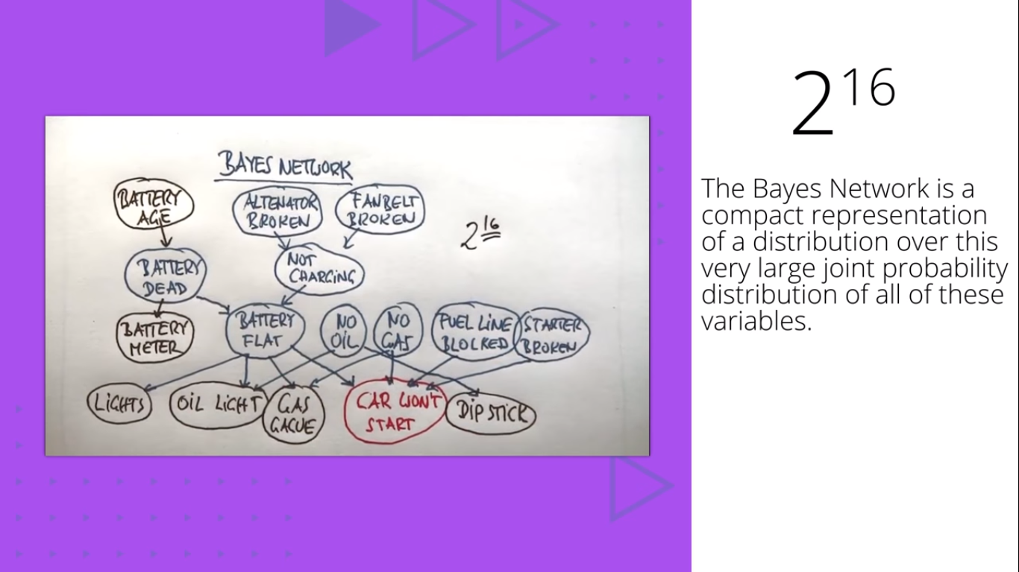

Slide 7
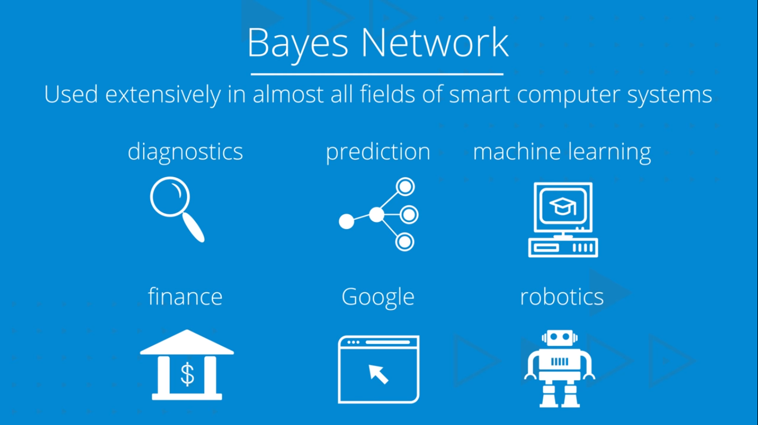

Slide 8
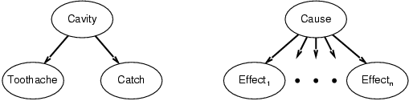
Bayes’ nets
Can be captured in a picture, where the arcs capture conditional independence relationships

Slide 9
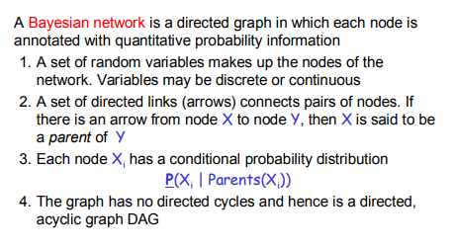
Bayesian Network

Slide 10
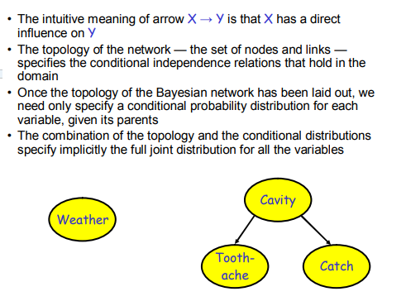

Slide 11
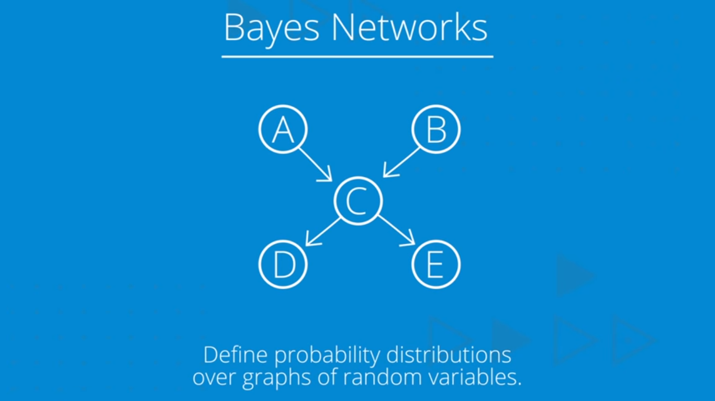

Slide 12
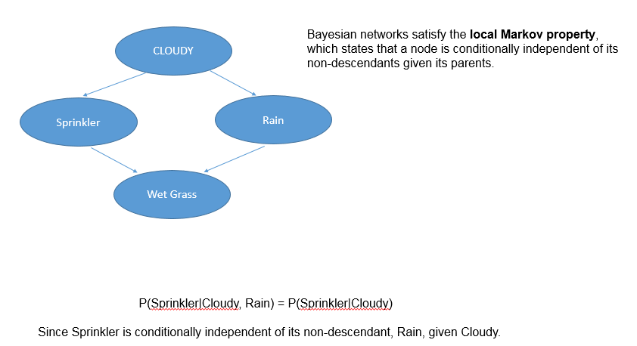

Slide 13
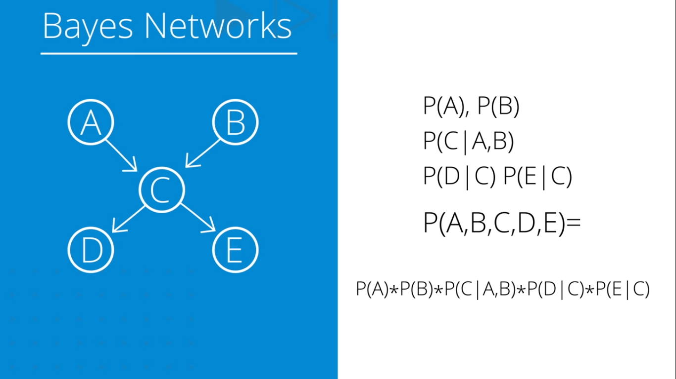

Slide 14
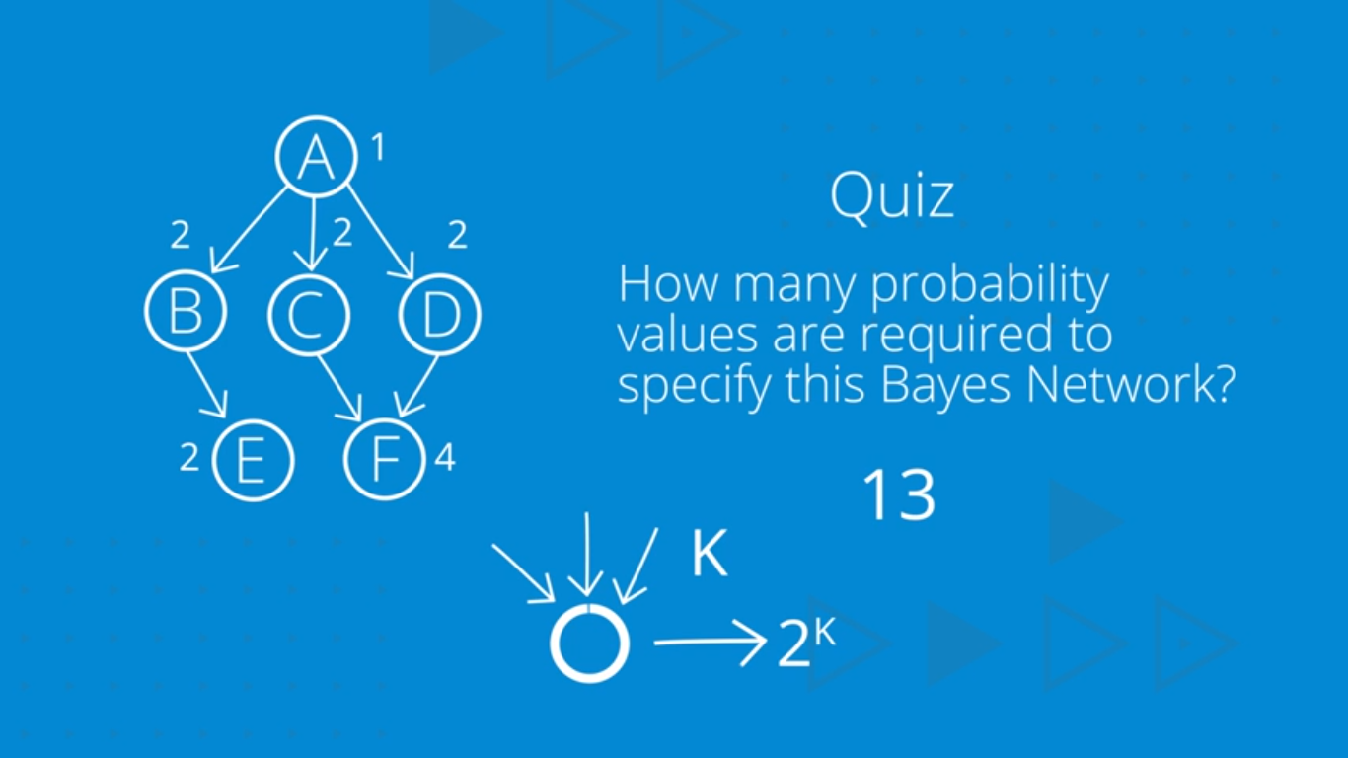

Slide 15
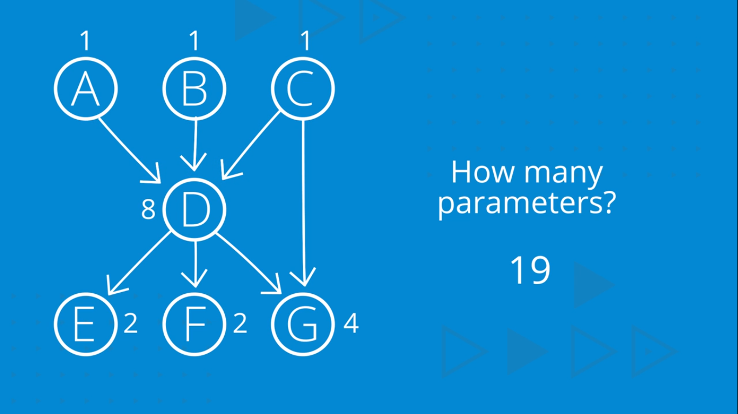

Slide 16
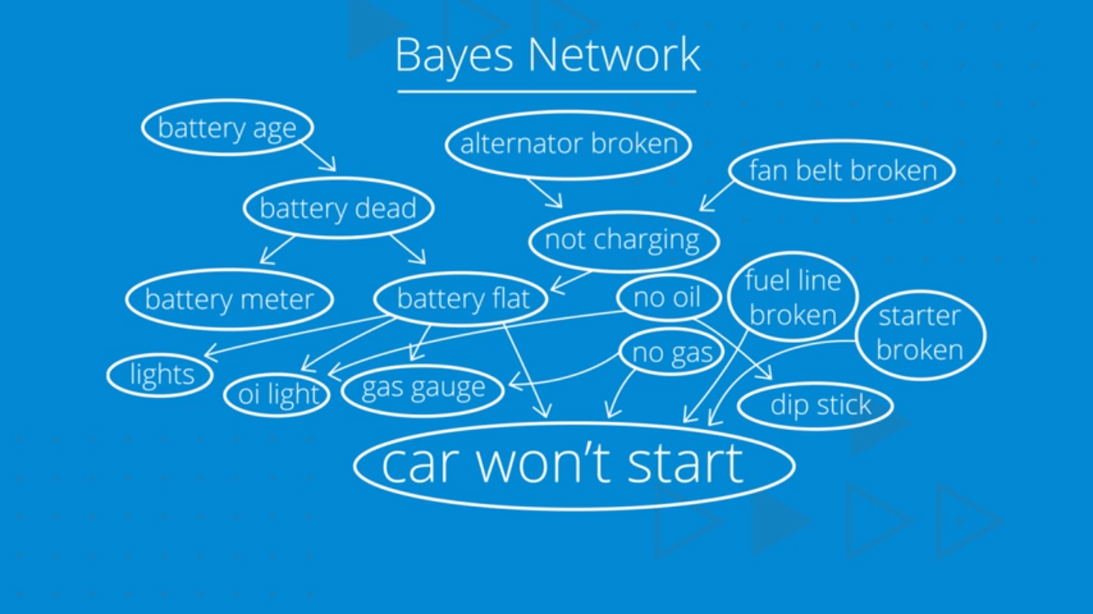

Slide 17
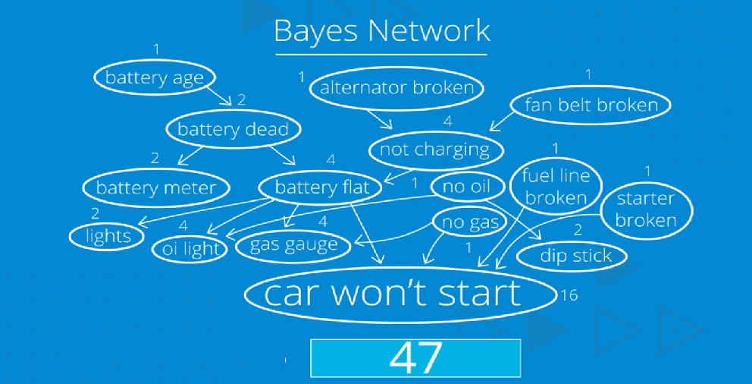

Slide 18
Three Basic Types Of Probabilities
Joint probability: Likelihood of a completely specified state of events, e.g. P(ABCDE)
Marginal probability: Likelihood of an incompletely specified state of events, e.g. P(ACD) or P(E)
Conditional probability: Likelihood of an event given some known information, e.g. P(A|C) or P(DE|AB)

Slide 19
Joint probability distribution:
If we have variables x1, x2, x3,....., xn, then the probabilities of a different combination of x1, x2, x3.. xn, are known as Joint probability distribution.
P[x₁, x₂, x₃,....., x_{n}], it can be written as the following way in terms of the joint probability distribution.
= P[x₁| x₂, x₃,....., x_{n}]P[x₂, x₃,....., x_{n}]
= P[x₁| x₂, x₃,....., x_{n}]P[x₂|x₃,....., x_{n}]....P[x_{n-1}|x_{n}]P[x_{n}].

Slide 20
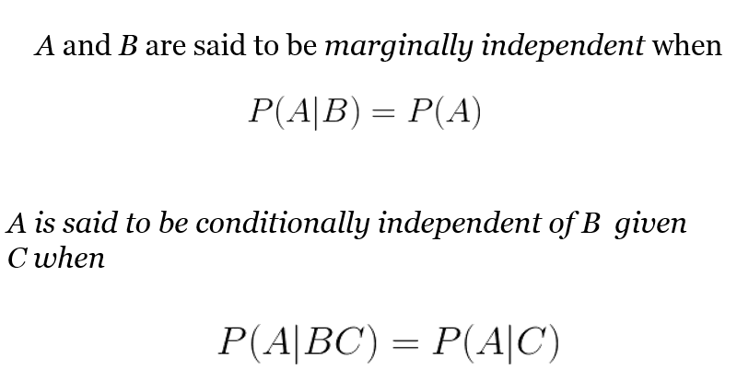

Slide 21
Markov Models
Set of states:
Process moves from one state to another generating a sequence of states :
Markov chain property: probability of each subsequent state depends only on what was the previous state:
To define Markov model, the following probabilities have to be specified:
Transition probabilities
Initial probabilities

Slide 22
Example of Markov Model
0.3
0.7
Rain
Dry
0.2
0.8
Two states : ‘Rain’ and ‘Dry’.
Transition probabilities:
P(‘Rain’|‘Rain’)=0.3 ,
P(‘Dry’|‘Rain’)=0.7 ,
P(‘Rain’|‘Dry’)=0.2,
P(‘Dry’|‘Dry’)=0.8
Initial probabilities: say P(‘Rain’)=0.4 , P(‘Dry’)=0.6 .

Slide 23
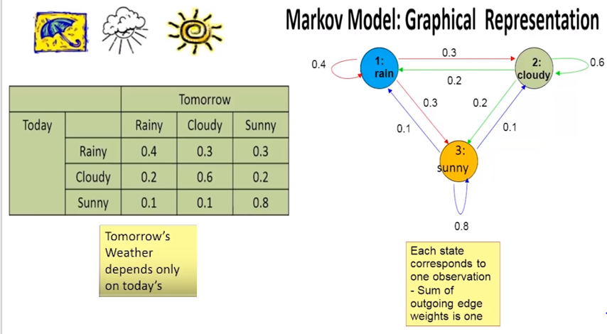

Slide 24
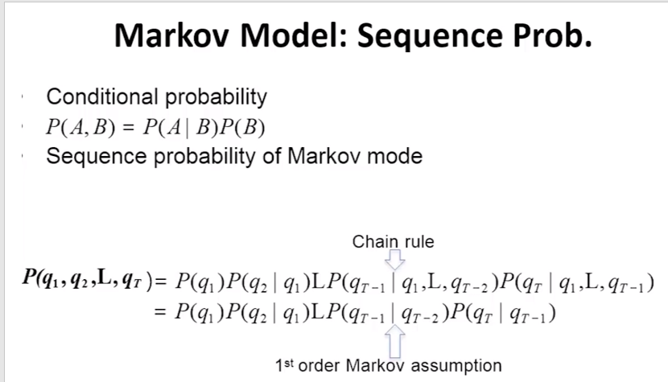

Slide 25
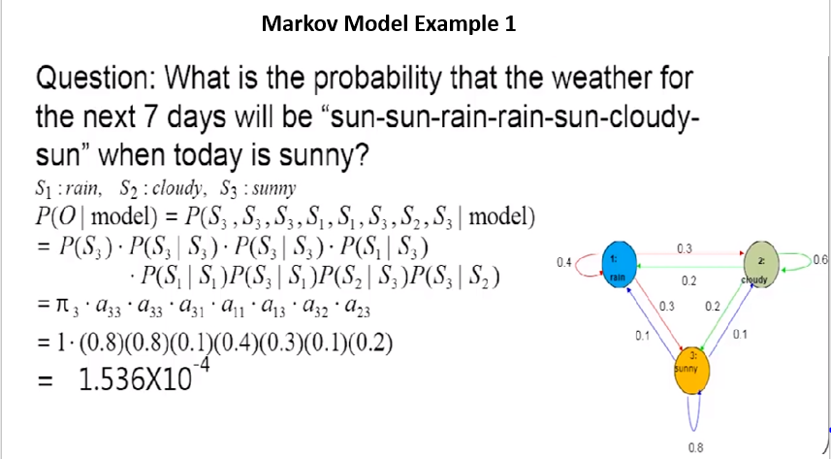

Slide 26
